Slide 1
Face mask detection
Open innovation

Slide 2
Problem statement
The goal of this challenge is to train object detection models capable of identifying the location of masked faces in an image as well as the location of unmasked faces in the image. These detectors should be robust to noise and provide as little room as possible to accommodate false positives for masks due to the potentially dire consequences that they would lead to. Ideally, they should be fast enough to work well for real-world applications, something we hope to focus on in future rounds of the competition

Slide 3
Dataset
The dataset that would be used is a growing dataset from a combination of many sources, either hand-labeled or pseudo-labeled. The dataset would contain annotations for masked faces, unmasked faces as well as some images that don't have any annotations as would be the case in the real-world scenario.

Slide 4
Motivation
In the present scenario due to Covid-19, there is no efficient face mask detection applications which are now in high demand for transportation means, densely populated areas, residential districts, large-scale manufacturers and other enterprises to ensure safety. Also, the absence of large datasets of ‘with_mask’ images has made this task more cumbersome and challenging.

Slide 5
Features
Our face mask detector didn't use any morphed masked images dataset. The model is accurate, and since we used the MobileNetV2 architecture, it’s also computationally efficient and thus making it easier to deploy the model to embedded systems (Raspberry Pi, Google Coral, etc.).
This system can therefore be used in real-time applications which require face-mask detection for safety purposes due to the outbreak of Covid-19.

Slide 6
Tools Used for model:
NumPy : Used for storing and manipulating high dimensional arrays.
Matplotlib : Used for plotting.
OpenCV : Used for manipulating images and video streams.
Keras : Used for designing and training the Face_Mask_Classifier model.
Scikit-Learn : used for train-test and perform one-hot encoding on the labels.
imutils : A series of convenience functions to make basic image processing functions such as translation, rotation, resizing, skeletonization, displaying Matplotlib images, sorting contours, detecting edges, and much more easier with OpenCV and both Python 2.7 and Python 3.
numpy : used to convert the data into array format.

Slide 7
Solution we have used for this model:
In order to train this dataset I used a pre-trained model “MOBILE NET”, which we call this process as Transfer learning, where I removed the prediction layer for this model. I used ‘IMAGENET’ which helps to enhance the model to avoid problems like ovefit and less accurate situations. Each images is resized into 244*224 dimension.
Another main important aspect I used to avoid overfit is DATA AUGMENTATION. By using IMAGE DATA GENERATOR present in “tf.keras.preprocessing.image.ImageDataGenerator” I generated augmented images.

Slide 8
aug = ImageDataGenerator( rotation_range = 20, zoom_range = 0.15, width_shift_range = 0.2, height_shift_range = 0.2, sheer_range = 0.15, horizantal_flip = True, fill_mode = ‘nearest’ )”
Network is trained at 5 epochs, It achieved an accuracy of 0.9806 and val_accuracy of 0.9883, loss is 0.0620, val_loss is 0.0403
At the model hierarchy we included a mobile-net model, next I added AveragePooling2D(), Flatten(), Dense(), Dropout() layers. Prediction layer contains 2 neurons with ‘softmax’ as activation function. In model compile, adam with learning rate 0.0001, binary_crossentropy is used as loss function, accuracy is used as metrics.

Slide 9
Steps to be performed before Data Preprocessing
Import the libraries required for the model.
load images from the local folder.
Total there are 1900 mask images and 1900 with out mask images are available in the folder.
After loading apply preprocess_input to every image because here for developing the model we are using 'MOBILE NET'.
Create the two lists( data and labels) one is used to store image arrays and another one used to store what type of images are present in data list according to specific position.
(suppose if the image in data array at 1 loc is belongs to with out mask then the key word “with ouk mask ” is stored at 1st location of the labels list.

Slide 10
Data preprocessing
1.perform one-hot encoding on the labels list by using LabelBinarizer.
2.covert the two lists (data and lables) into array format by using numpy .
3.Here we are converting the two lists into array format because of train-test split.
4.perform the train_test_split on the data array and list array for training and testing the model with random_state=0 and train size 80 percent and test size 20 percent of the dataset.

Slide 11
2.Model Building
1.load the MobileNetV2 network, ensuring the head FC layer sets are
2.construct the head of the model that will be placed on top of the
3.place the head FC model on top of the base model (this will become the actual model we will train)
4.loop over all layers in the base model and freeze them so they will *not* be updated during the first training process
5.compile our model

Slide 12
3.Training the model
Train the model with 5 no of epochs.
# train the head of the network
print("[INFO] training head...")
H = model.fit(
aug.flow(trainX, trainY, batch_size=BS),
steps_per_epoch=len(trainX) // BS,
validation_data=(testX, testY),
validation_steps=len(testX) // BS,
epochs=5)

Slide 13
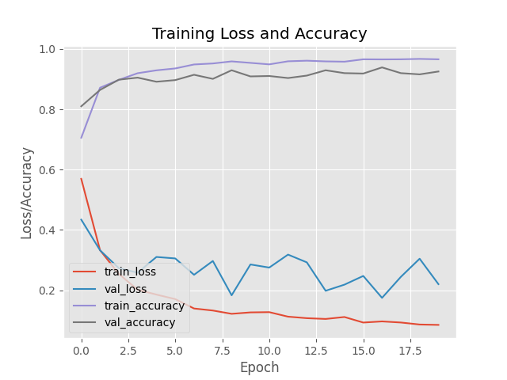
Predictions on test data set
for each image in the testing set we need to find the index of the
label with corresponding largest predicted probability.
Prepare the classification by using predictions of the model.

Slide 14
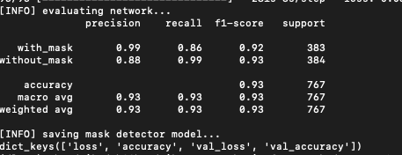
Accuaracy
Our model gave 93% accuracy for Face Mask Detection after training via tensorflow-gpu==2.0.0
our model is good form the test data.

Slide 15
Detecting the face and mask With the help face detector model the model detects the face and with the help of mask detector model the model detects the mask. by using dnn in cv2 library the face detector detects the face.
library

Slide 16
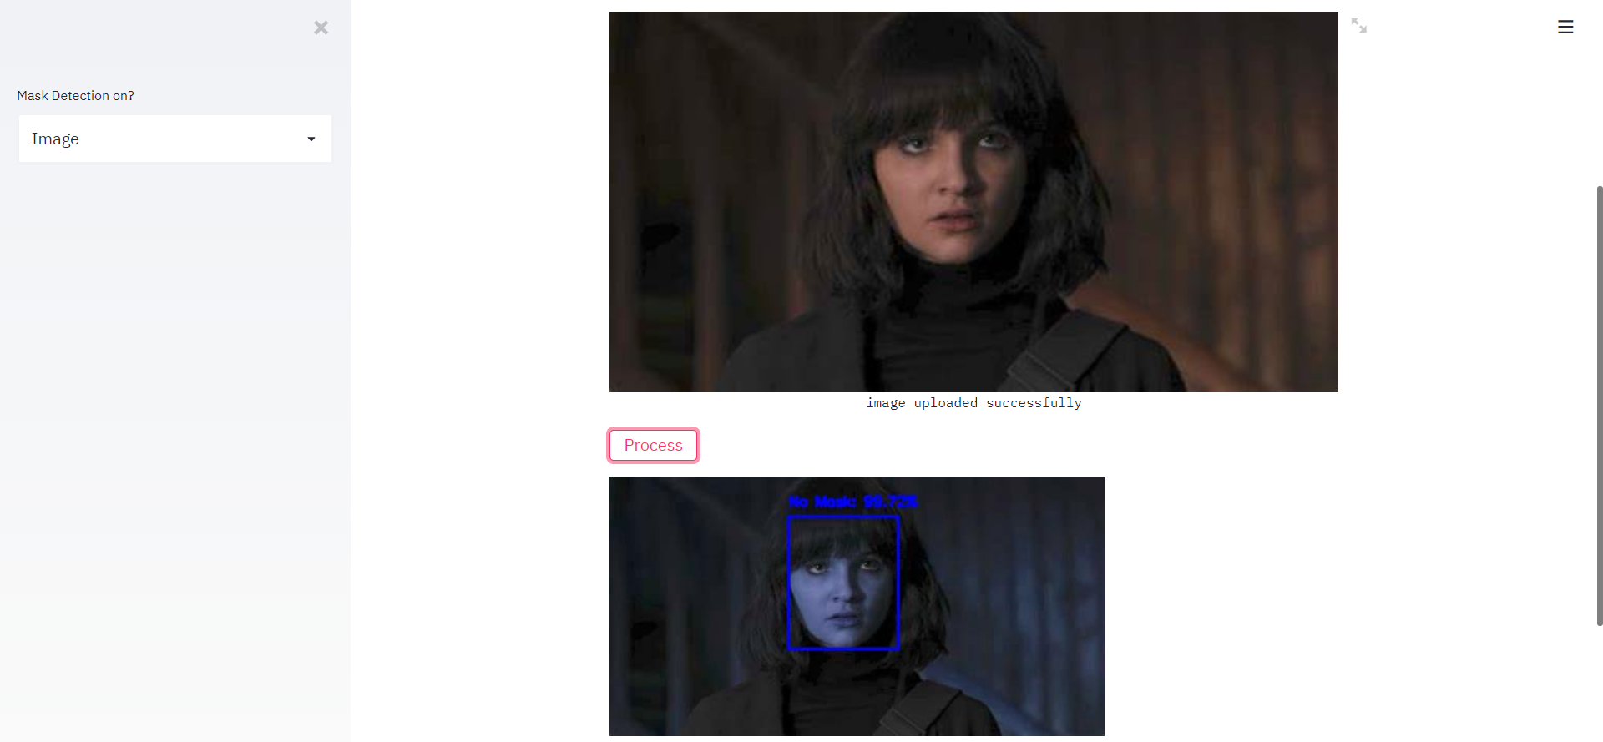
1.Connect to the webcam by using cv2 library
2.by using both face detector and mask detector we conclude that if the
person is had mask or not with accuracy.

Slide 17
test data code
import numpy as np
from keras.preprocessing import image
test_image = image.load_img(r'D:\fm\image-1.jpg', target_size = (224, 224))
plt.imshow(test_image)
test_image = image.img_to_array(test_image)
test_image = preprocess_input(test_image)
test_image = np.expand_dims(test_image, axis=0)
result = model.predict(test_image)

Slide 18
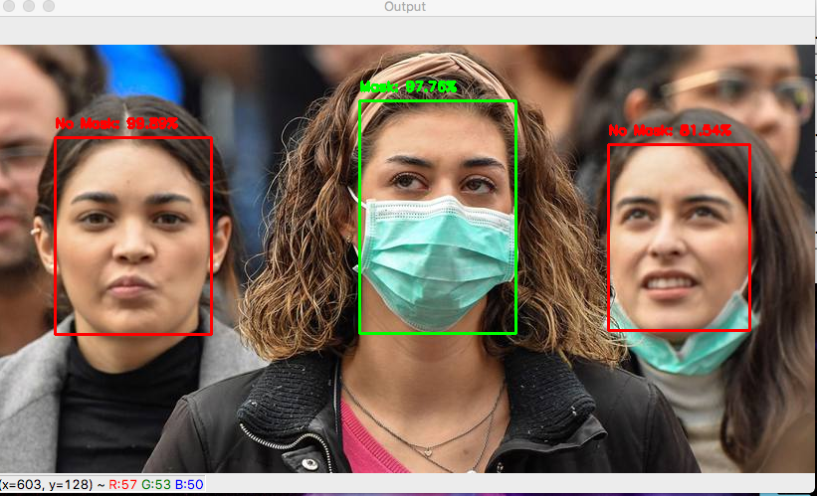
Some samples test images are

